Slide 1


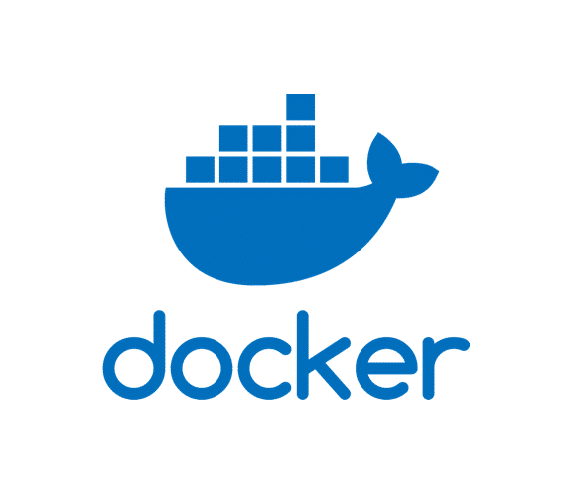

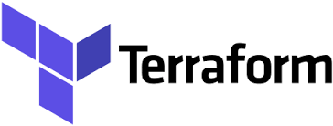



DevSecOps Workflow
Develop
Commit
Build
Publish
Provision & Deploy
Operate
VS CODE
Code
Docker File
Terraform laaC
Jenkins Pipeline

Slide 2








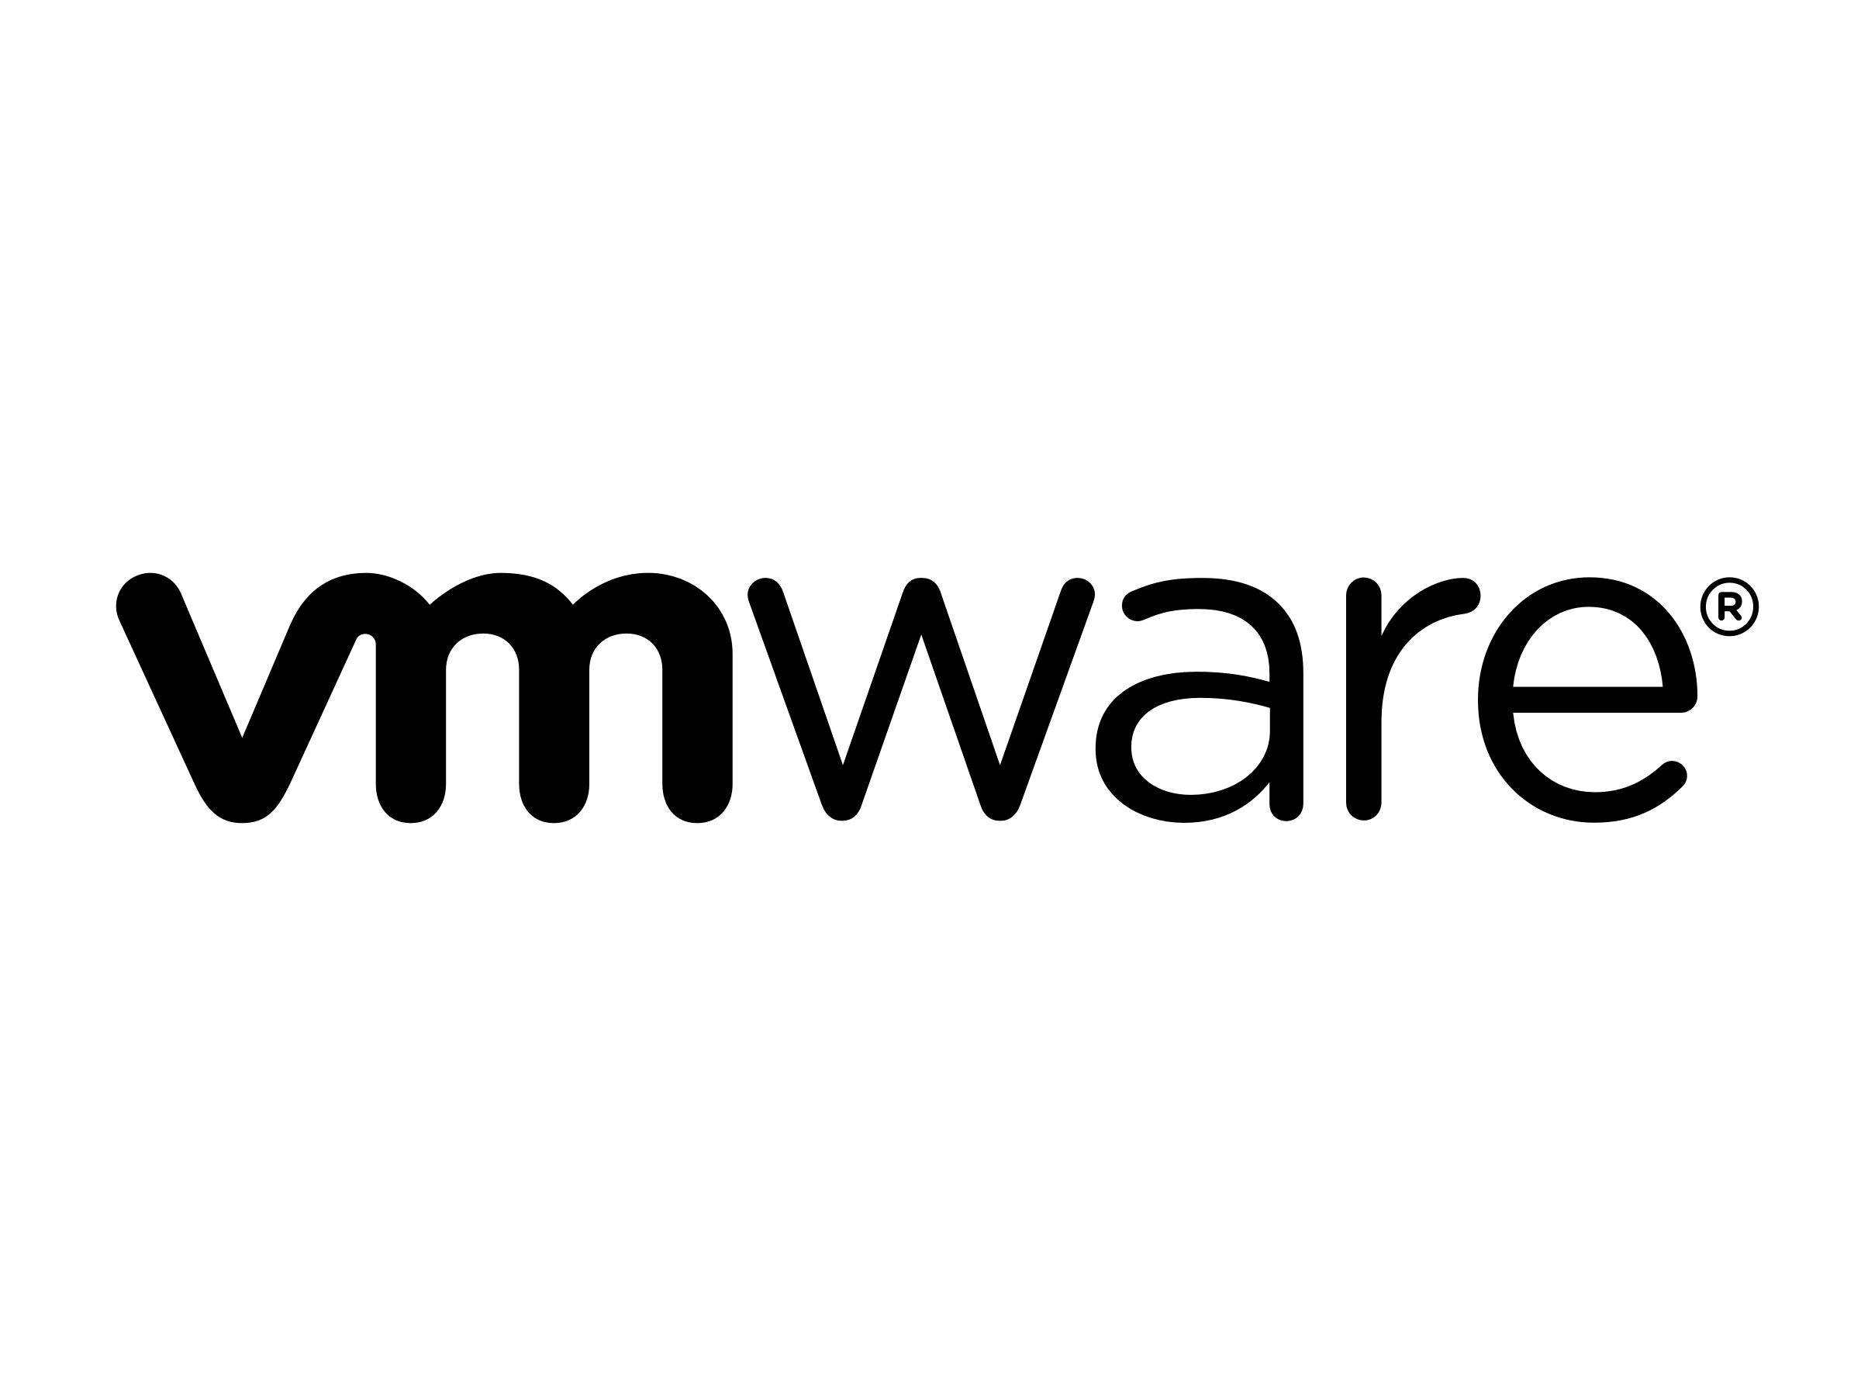
Terraform Architecture
Terraform Plan Terraform Apply
Terraform Core
State File (.tfstate)
Azure
GCP
DevOps/Infra Engineer
Terraform manifest files (.tf)
Providers
Azure, GCP, AWS, VMware, etc.
Cloud Service Providers
Provisioners
Remote-exec, Local exec, etc.
Plugins

Slide 3

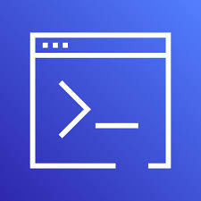
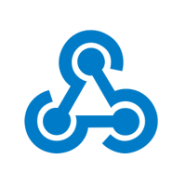




Terraform Implementation - workflow
Installing Required Software
Run Docker images
Apply the changes to existing Environment
Pulling Required images for tfsec, tflint and costing
Executing Terraform Init, Plan, Validate
Generating Logs for Cost Estimation and Tfsec
Upload tfsec and cost files into Object Storage
Publish Release
Code Commit
Terraform
Tfsec
Terraform Install
if Branch = main
Yes
Trigger
Azure CLI
Linting
Terraform INIT
Parameter
Docker
Cost Estimation
Publish Report
Terraform apply
Coding
Continuous Integration
Continuous Deployment
Build Pipeline
Release Pipeline

Slide 4
Terraform – SAST Workflow
Code Pushed to Branch
Sonar Analysis
Where has the change been made?
Run unit tests
/ambdas or /scripts
GitGuardian Scan
/terraform/core
Terraform Plan
/terraform/etl
Terraform Compliance
Terraform Lint
/terraform/networking
/terraform/backend-setup
Validate and Lint Terraform
End/CD Process is triggered
Merge Pull Request
Wait for 2 approvals on Pull request

Slide 5



Terraform IaaC - SAST
CI trigger
Code Commit & Push
Compile TF Configuration
8 Total Tests
1 Passed
7 Failed Test
12.5%
Pass Percentage
7 Failed
0 New
0 Others
7 Existing
Skundunotes: Static analysis with Checkov, Terraform, and Jenkins Pipelines

